Slide 1
Interconnection networks

Slide 2
Interconnection networks
.
Characteristic of multiprocessor system – ability of each processor to share a set of main memory modules and I/O devices.
This sharing capability is provided through a set of 2 interconnection n/w’s.
One b/w the processor and memory modules
other b/w processors and I/o subsystem

Slide 3
There are different physical forms available for interconnection networks.
They are:
Time shared or common bus,
Crossbar switch
Multistage networks for multiprocessors.

Slide 4
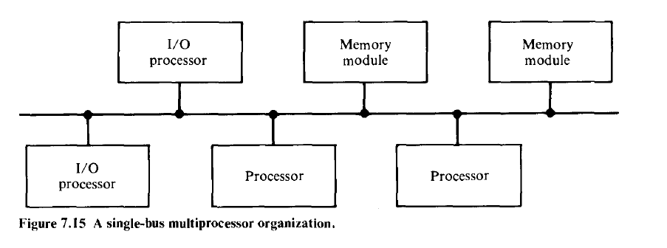
1.Time shared or common bus
The simplest interconnection system for multiple processors is a common communication path connecting all of the functional units.
Common path is called a time shared or common bus.
It is the least complex and easiest to reconfigure.

Slide 5
Such an interconnection n/w is a passive unit having no active components such as switches.
Transfer operations are controlled completely by the bus interfaces of the sending and receiving units.
Since the bus is a shared resource, a mechanism must be provided to resolve contention.
The conflict resolution methods include static or fixed priorities, FIFO queues and daisy chaining.
An eg of the time shared bus is the PDP -11

Slide 6
The single bus organization is quite reliable and relatively inexpensive,
System expansion by adding more processors or memory increases the bus contention, which degrades system throughput and increases arbitration logic.
The total overall transfer rate within the system is limited by the bandwidth and speed of this single path

Slide 7
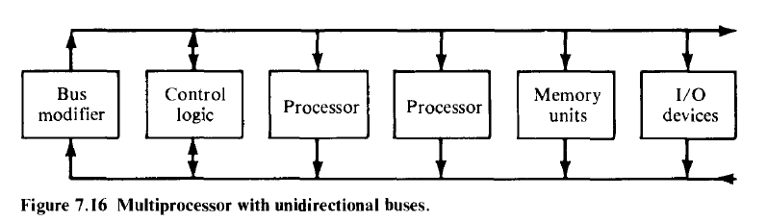
An extension of the single path organization to 2 unidirectional paths.

Slide 8
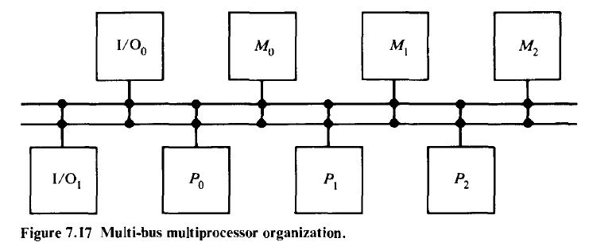
Multiple bidirectional buses can be used to permit multiple simultaneous bus transfers.

Slide 9
Algorithms for bus arbitration
(a) Static priority algorithm
Digital buses assign unique static priorities to the requesting devices.
When multiple devices concurrently request use of the bus, device with the highest priority is granted access to it.
This approach is implemented using a scheme called daisy chaining, in which all services are effectively assigned static priorities according to their locations along a bus grant control line.

Slide 10
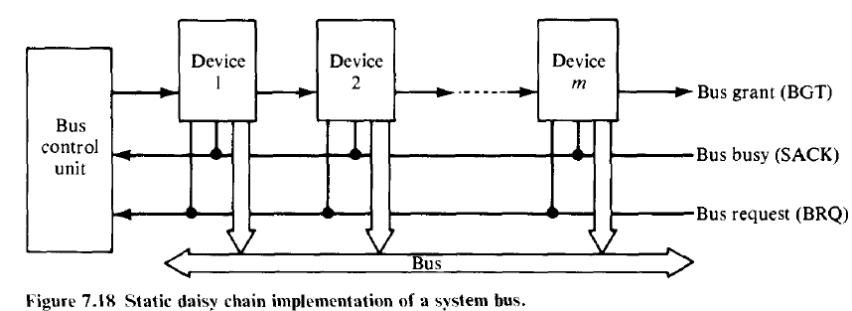
Device close to the central bus controller is assigned the highest priority.
Requests are made on a common request line, BRQ. The central bus control unit propagates a bus grant signal BGT if the acknowledge signal SACK indicates that the bus is idle.

Slide 11
(b)Fixed time slice algorithm
This divides the available bus band width into fixed length time slices that are then sequentially offered to each device in a round robin fashion.
Should the selected device elect not to use the time slice, the time slice remains unused by any device.
The technique is called fixed time slicing (FTS) or time division multiplexing (TMD).

Slide 12
(c)Dynamic priority algorithm
----LRU(least recently used)
----RDC(rotating daisy chain)
The LRU algorithm gives the highest priority to the requesting device that has not used the bus for the longest interval. This is accomplished by reassigning priorities after each bus cycle.
In the daisy chain scheme all devices are given static and unique priorities on a bus grant line emanating from a central controller.

Slide 13
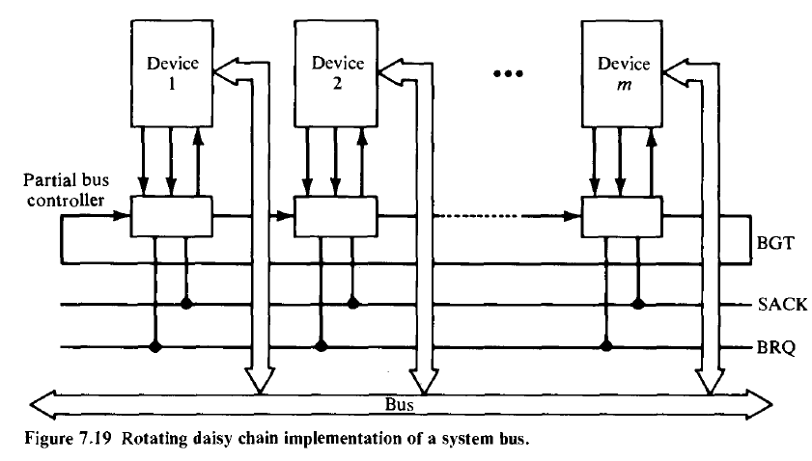
In the RDC scheme, no central controller exists and the bus grant line is connected from the last device back to the first in a closed loop. Whichever device is granted access to the bus serves as the bus controller for the following arbitration.

Slide 14
(d)The FCFS algorithm
Requests are honored in the order received.
Scheme is symmetric because it favors no particular processor or device on the bus; thus it load balances the bus requests.
2 difficult reasons to implement FCFS
Mechanism to record the arrival order of all pending requests
It is always possible for 2 bus requests to arrive within a sufficiently small interval.

Slide 15
(e) polling
In a bus controller that uses polling, the bus grant signal, BGT of the static daisy chain is replaced by a set of [log2m] polling lines.
The set of poll lines is connected to each of the devices.
On a bus request, the controller sequences through the device address by using the poll lines. When a device Di which requested access recognizes its address, it raises the SACK line.

Slide 16
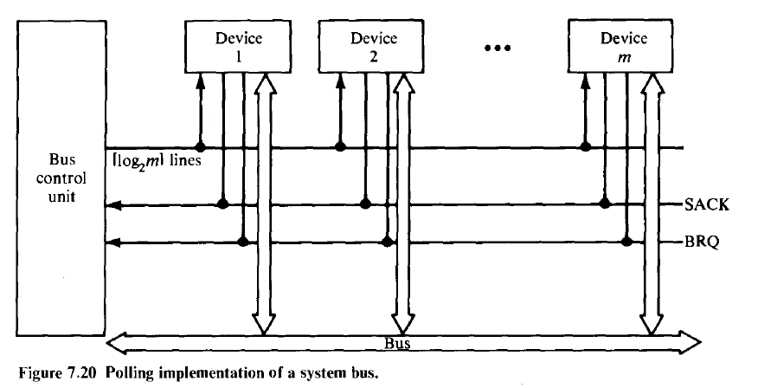

Slide 17
(f) Independent requesting
In the independent requesting technique, a separate bus request (BRQ) and BGT line are connected to each device i sharing the bus.
This requesting technique can permit the implementation of LRU, FCFS etc.

Slide 18
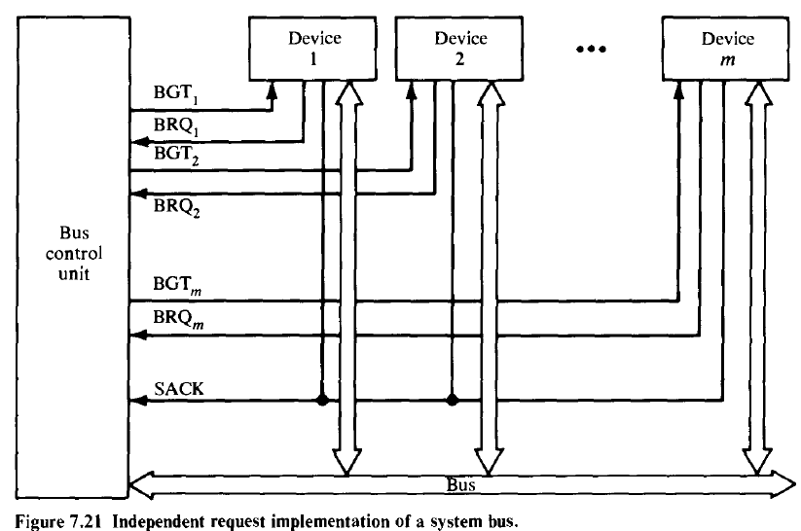

Slide 19
2. Crossbar switch and multiport memories
If the number of buses in a time shared bus system is increased a point is reached at which there is a separate path available for each memory unit.
The interconnection network is called a nonblocking crossbar.
Crossbar (nonblocking) switch system organization for multiprocessors

Slide 20
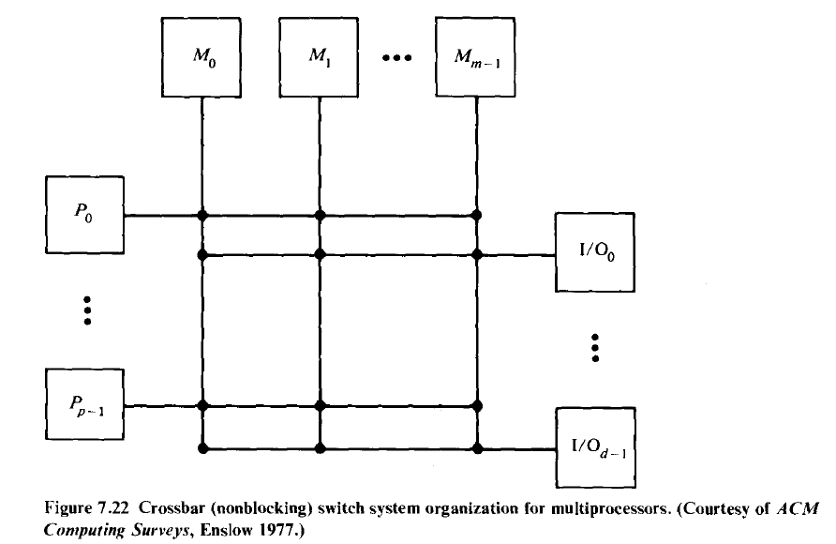

Slide 21
Crossbar Switch

Slide 22
The cross bar switch possesses complete connectivity with respect to the memory modules because there is a separate bus associated with each memory modules.
Therefore the max. no. of transfers that can take place simultaneously is limited by the no. of memory module and the band width speed product of the buses rather than by the no. of paths available.

Slide 23
Characteristic of a system utilizing a crossbar interconnection matrix are
The extreme simplicity of the switch to functional unit interfaces
The ability to support simultaneous transfers for all memory units.

Slide 24
In a crossbar switch or multiported device conflicts occur when two or more concurrent requests are made to the same destination device.
Assume that there are 16 destination devices (memory modules)and 16 requestors (processors).
Functional structure of a cross point in a crossbar n/w

Slide 25
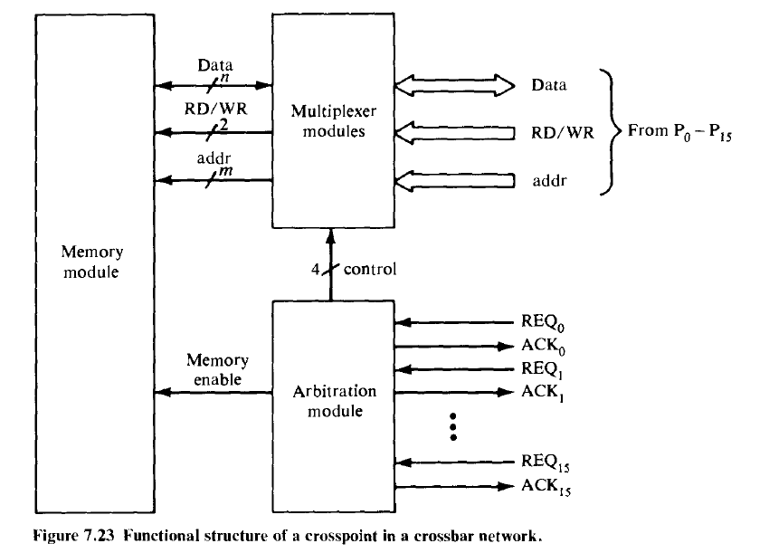

Slide 26
The switch consists of arbitration and multiplexer modules.
Each processor generates a memory module request signal (REQ) to the arbitration unit, which selects the processor with the highest priority. The selection is accomplished with a priority encoder.
The arbitration module returns an acknowledge signal ACK to the selected processor.
After the processor receives the ACK, it initiates its memory operation.
The multiplexer module multiplexes data, address of words within the module and control signals from the processor to the memory module using a 16to 1 multiplexer.

Slide 27
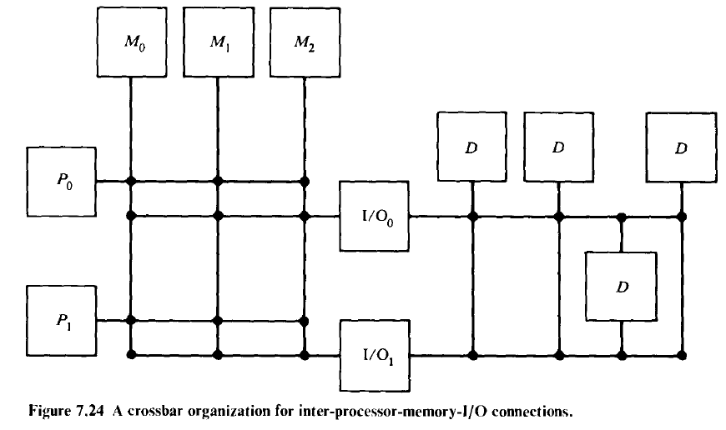
A crossbar organization for inter processor memory- I/O connection

Slide 28
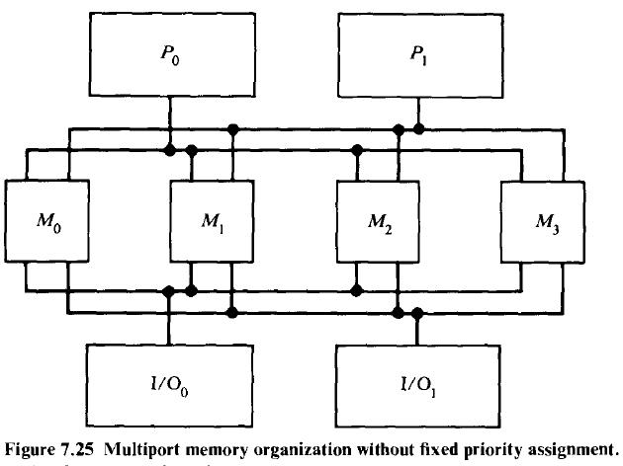
Multiport memory organization without fixed priority assignment

Slide 29
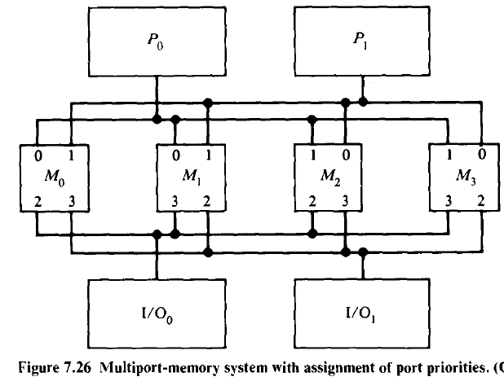
Multiport memory system with assignment of port priorities

Slide 30
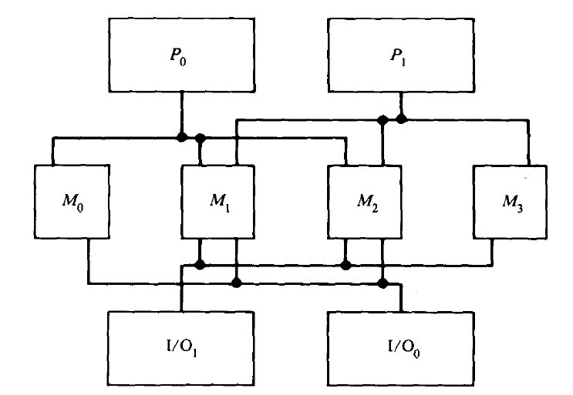

Slide 31
Multiport Memory Organization with private memories

Slide 32
Comparison of different multiprocessor hardware organization
Multiprocessor Time Shared bus
Low cost and least complex
Easy to physically modify the hardware system
Overall system capacity limited bus transfer rate(Bus failure affects the whole system)
Scalability may cause system performance
System efficiency is low
Appropriate for small systems only

Slide 33
Multiprocessor with crossbar switch
Complex ,but potential for highest total transfer rate
Since control and switching logic is in the switch, functional units are simpler and cheaper
Cost effective for multiprocessor only
System expansion improves performance
Expansion of the system limited to size of the switch matrix
Reliability of the switch can be improved by segmentation and/or redundancy within the switch

Slide 34
Multiprocessor with Multiport Memory
Requires most expensive memory
There is a potential for very high transfer rate
Size and configuration is limited by the no. and type of memory ports are available
A large no. of cables and connectors are required
The characteristics of functional units permits a relatively low uni-processor to be assembled for them

Slide 35
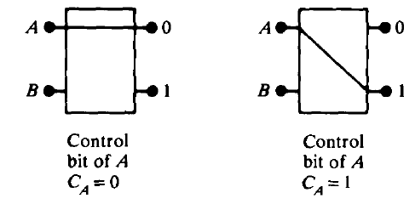
3. Multistage network for multiprocessors
This 2 x 2 switch has the capability of connecting the i/p A to either the o/p labeled 0 or the o/p labeled 1, depending on the value of some control bit C_{A} of the i/p A.
If C_{A}=0 the i/p is connected to the upper o/p and if C_{A}=1 the connection is made to the lower o/p.

Slide 36
Terminal B of the switch behaves similarly with a control bit C_{B}. If both i/ps A and B require the same o/p terminal, then only one of them will be connected and the other will be blocked or rejected.
The switch shown is not buffered. In such a switch, the performance may be limited by the switch setup time which is experienced each time with a rejected request is resubmitted.
To improve the performance buffers can be inserted within the switch.

Slide 37
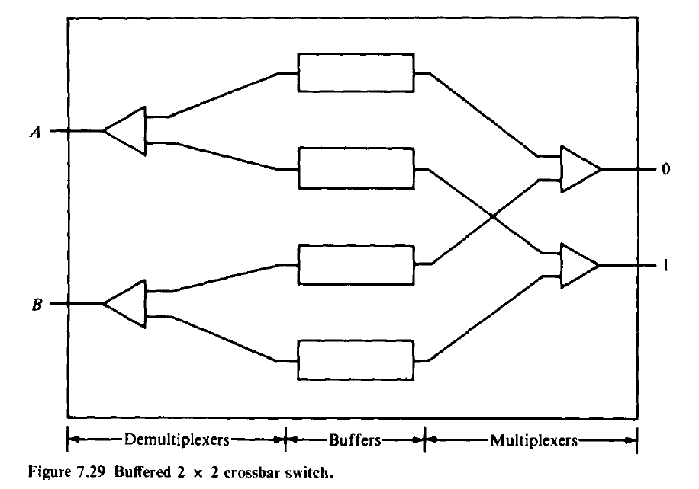

Slide 38
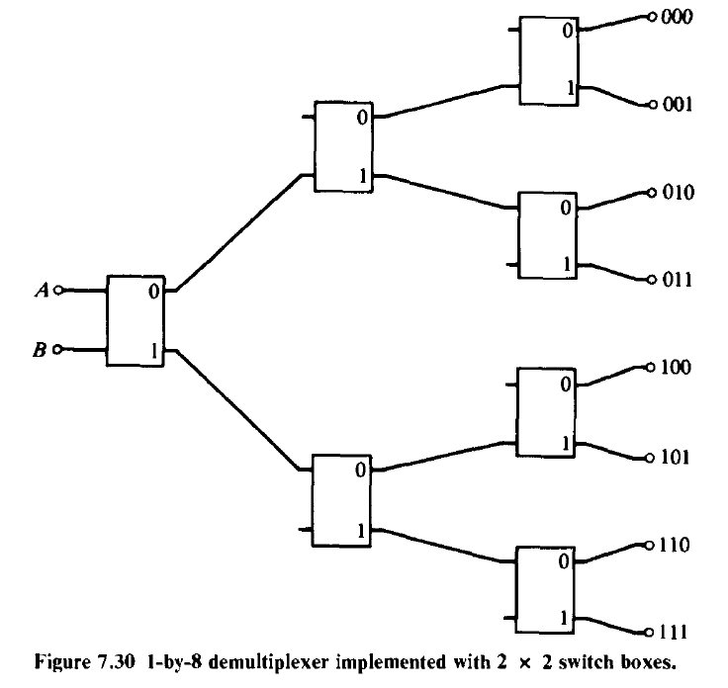
It is straightforward to construct a 1 x 2^{n} demultiplexer using the 2 x 2 module.
This is accomplished by constructing a binary tree of the modules is shown for a 1 x8 demultiplexer tree.

Slide 39
A banyan n/w can roughly be described as a partially ordered graph divided into distinct levels.
Nodes with no arcs faning out of them are called base nodes and
those with no arcs faning into them are called apex nodes.
The fanout f of a node is the no. of arcs faning out from the node.
The spread s of a node is the no. of arcs faning into it.

Slide 40
An (f,s,l) Banyan n/w can thus be described as a partially ordered graph with l levels in which there is exactly one path from every base to every apex node.
The fanout of each nonbase node is f and
the spread of each nonapex node is s.
Each node of the graph is an s x f crossbar switch.

Slide 41
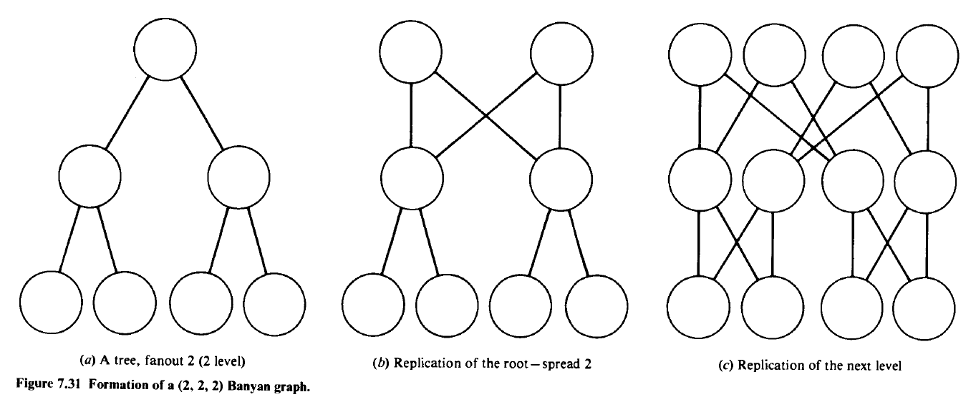

Slide 42
A delta network is defined as a^{n} x b^{n} switching n/w with n stages consisting of a x b crossbar modules.

Slide 43
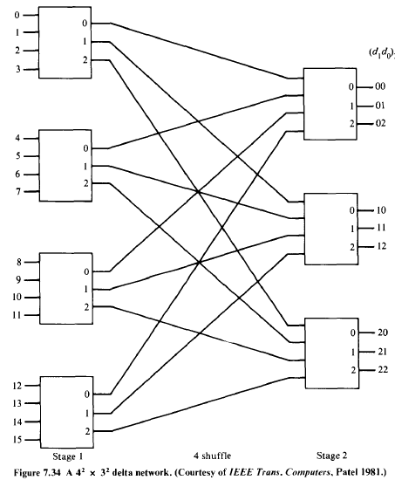

Slide 44
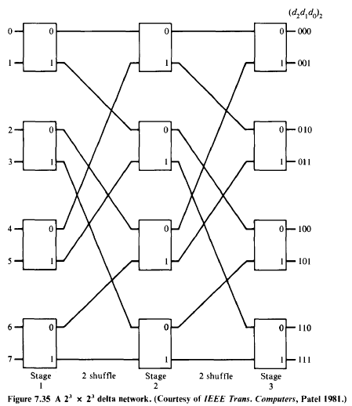

Slide 45
